Slide 1

Prototype Slides
Slide 1
Thanks Stacie.
Now coming to prototype.
At first, there can be some quarterly US bank initiative, inviting leadership from business lines to submit business issues, and that will get leadership buy in.
Then Business users will proceed with their business issues to OneBridge home page, where business processes information for various business lines will be available as well. Next Slide
Slide 2
Business User will enter description, attachments and will submit the business issue. Next Slide
Slide 3
Then collaboration will happen between business user, OneBridge Center Of Excellence and leadership. This can be seen in comments section like more information is asked on the business issue.
Once business issue has been verified and elaborated then this business issue along with other business issues can be filtered and will be moved to Ideation phase that uses integrations with current tools like IdeaPlace Or Bright Ideas Or Cap Ex committee will take over. Next Slide
Slide 4
Here is an example of IdeaPlace where business issue is posted as Business Challenge, that is inviting ideas/solutions from within US Bank. Next Slide
Slide 5
In this screen several ideas/ solution proposals can be seen that are posted by Innovation groups, TOS teams for the business challenge.
This completes our prototype. Next Slide

Slide 2
Value Propositions
Simplify your job. Increases Efficiency.
OneBridge streamlines the process and invites collaboration on business issues, that is managed by dedicated team (COE).
This will Make our job easier and simpler.
And by Improving the way we work, will also result in Better experience for our customers.
Little tweaks and better connection between available tools to achieve great value i.e.; One Stop Shop for business processes information and One Stop Shop to solve business issues
With pool of information available, innovative people can innovate. Bringing powerful combo of domain expert and technical people to forefront.
This will bring us closer as one Bank and will increase efficiency and revenue. Next Slide.

Slide 3
NEXT STEPS
Future of Innovation. . .
Phase1
For the next steps, in the first Phase we will exploit all resources to learn more about existing solutions.
We will partner with IdeaPlace to have a functional prototype ready, that we will use to do more of primary research/interviews.
In initial phase, we will focus on three business lines Wealth Management, Investment Services, WM TOS
Phase 2
In next phase we will further improve the integration between One Bridge and other ideating tools.
And will add additional business lines to the platform. Next Slide.

Slide 4
Lessons Learned
We learned a lot through this awesome IIR journey.
We learned a lot through this awesome IIR journey.
One very important thing we learned is to always test our theory and hunch.
We also improved our experimentation/ interview techniques.
We were able to meet new people.
And we learned great tools like IdeaPlace, Yammer, InVision.
We improved our skillset through great workshops. Like Design Worskhop, Customer Empathy Map, Primary/Secondary Research, Journey Maps, Story Telling.
IIR is awesome and IIR team is awesome. Thank you.

Slide 5
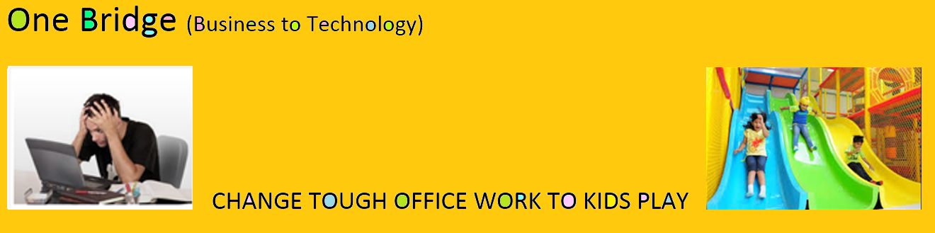
Thank you. Questions
Let’s collaborate.

Slide 6
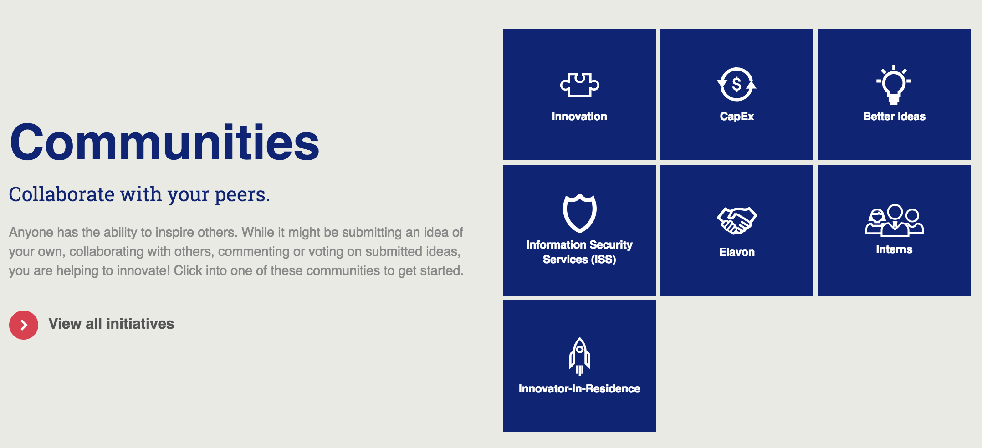
Appendix A -
[How this is different from IdeaPlace?]
[IdeaPlace is the platform, whereas OneBridge is the program. OneBridge will offer collaboration on business issues and will house business process information. OneBridge will gather business issues and improve connections with other tools so that problems move on seamlessly to ideation. Please see below an example of another program “Bright Ideas” using IdeaPlace as platform]

